Slide 1
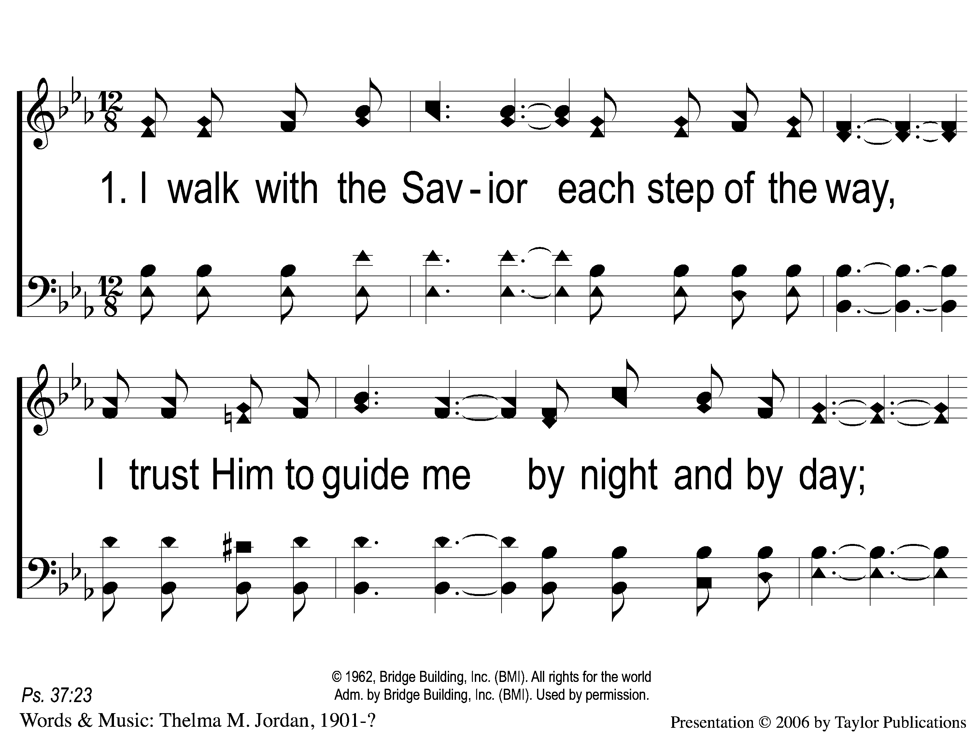
1-1 Each Step of the Way
Each Step of the Way
96

Slide 2
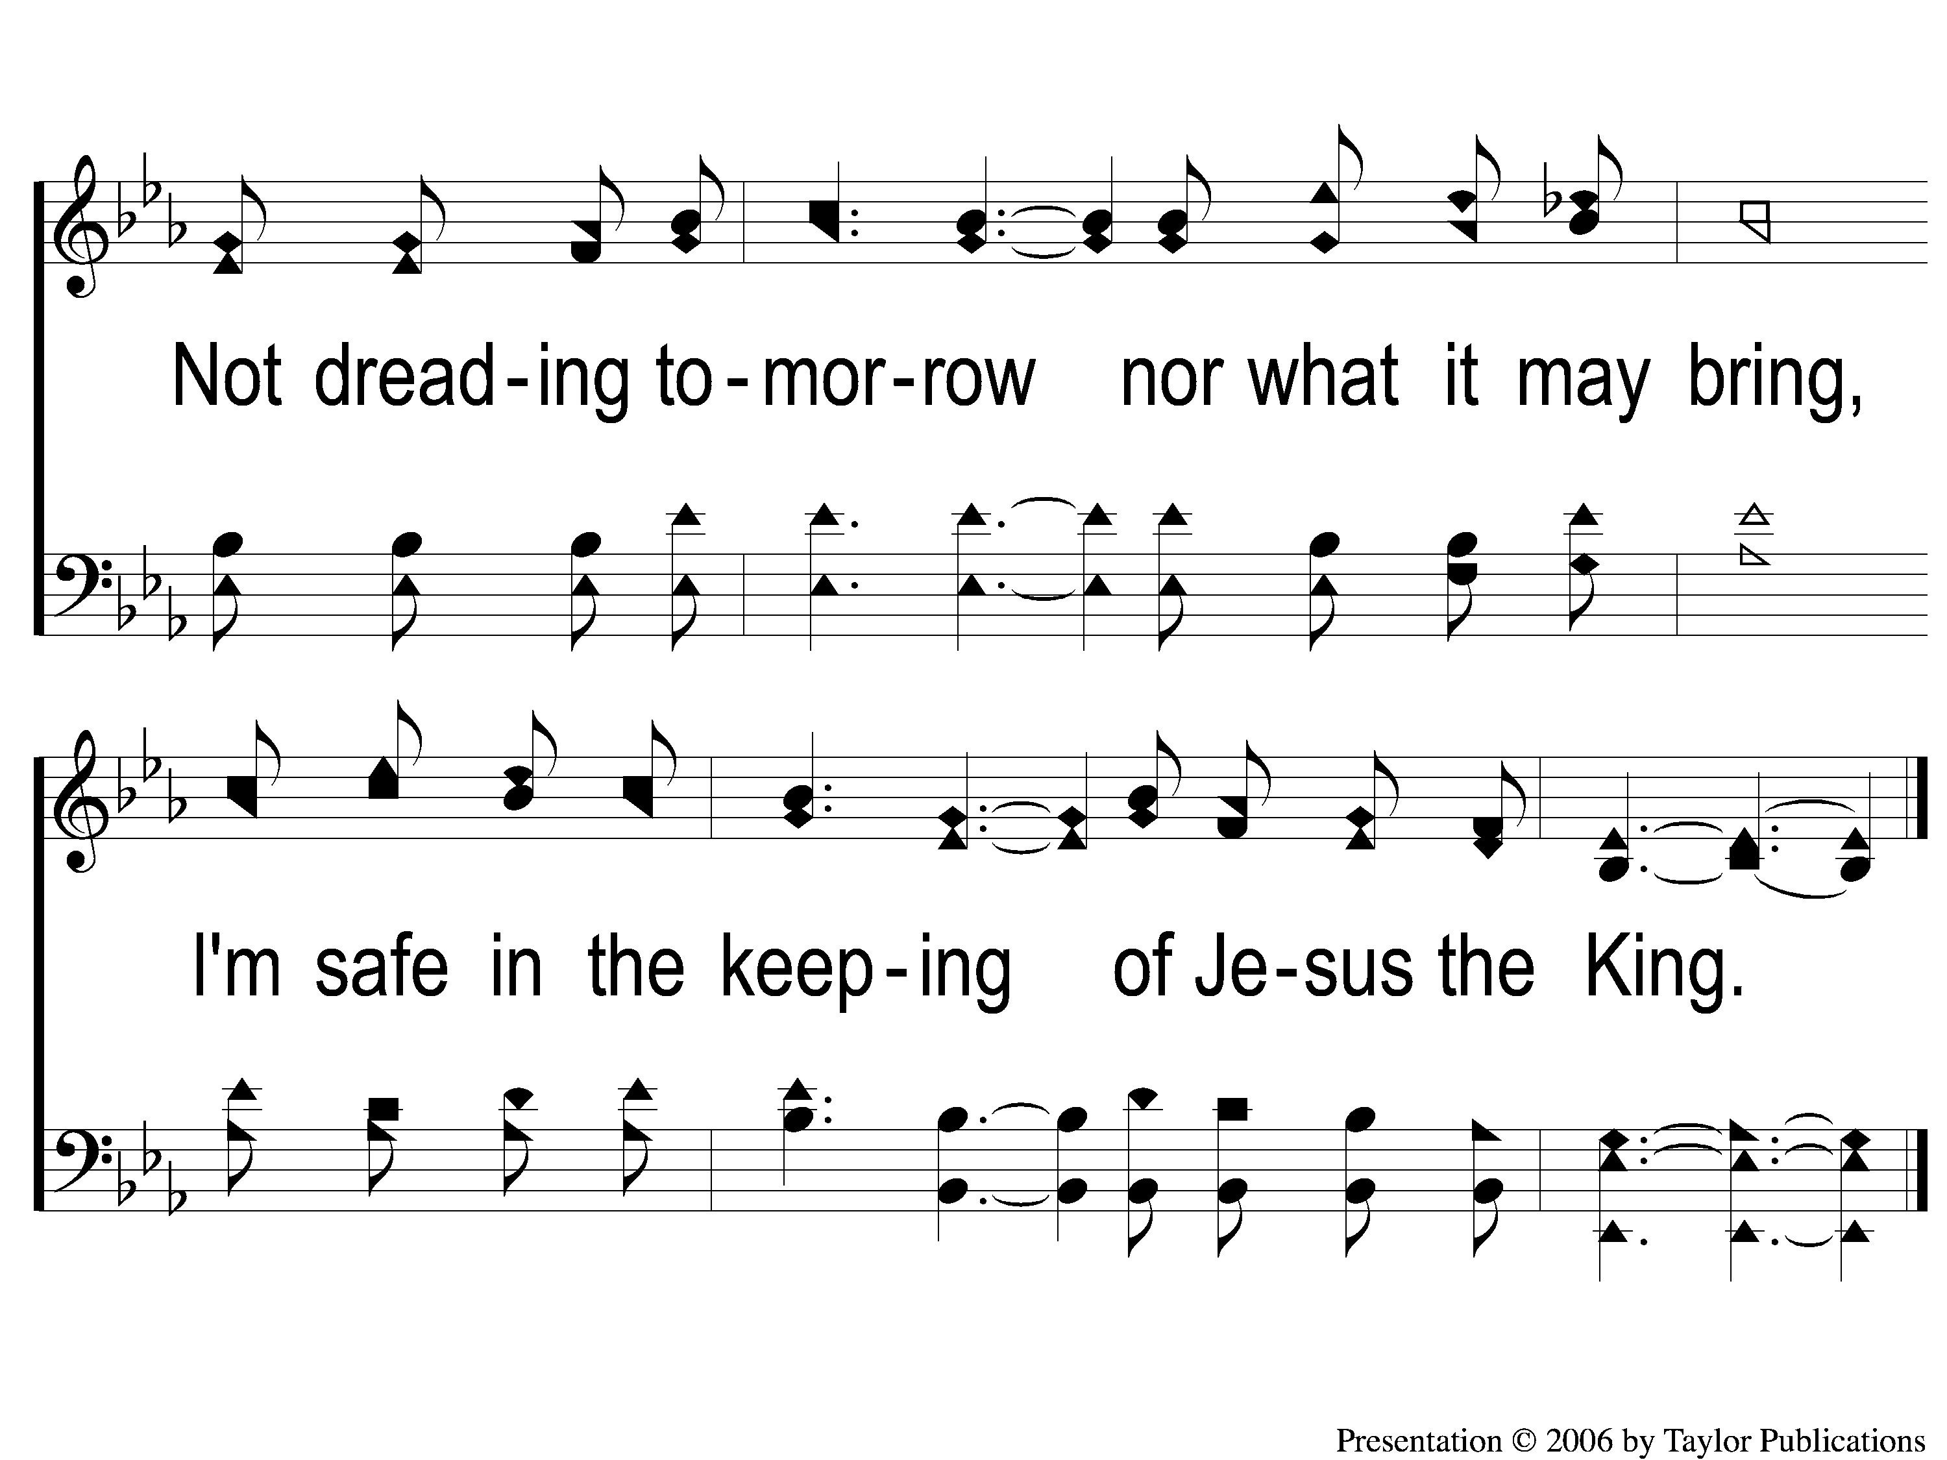
1-2 Each Step of the Way
Each Step of the Way
96

Slide 3
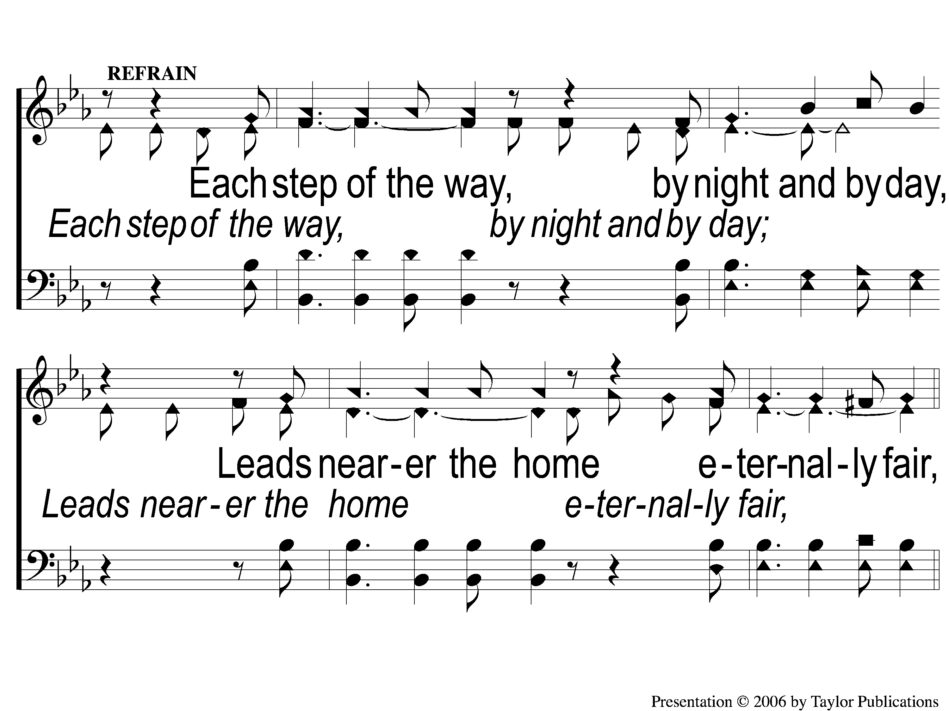
C-1 Each Step of the Way
Each Step of the Way
96

Slide 4
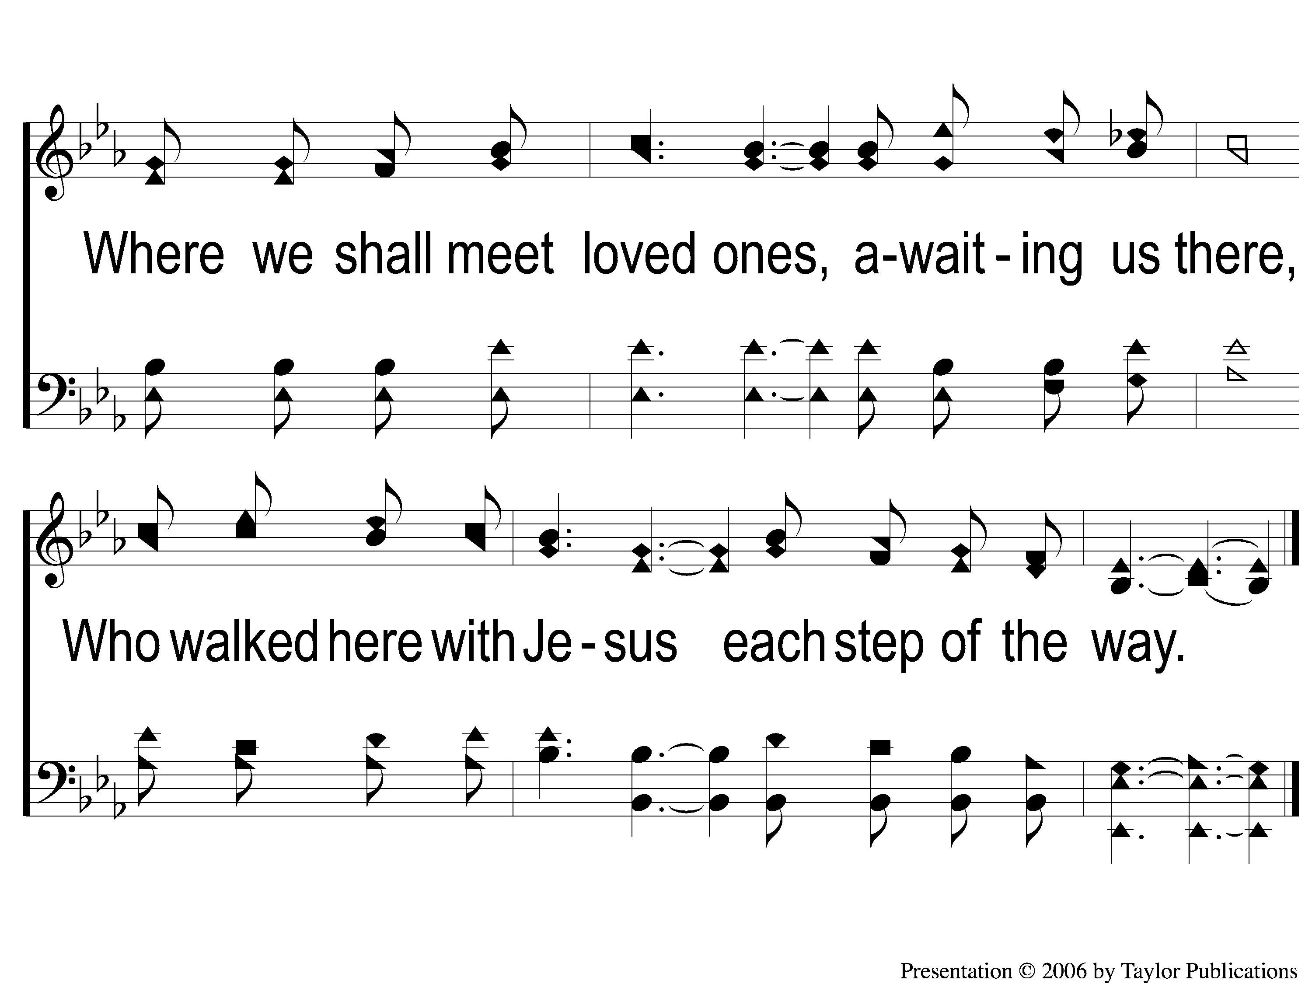
C-2 Each Step of the Way
Each Step of the Way
96

Slide 5
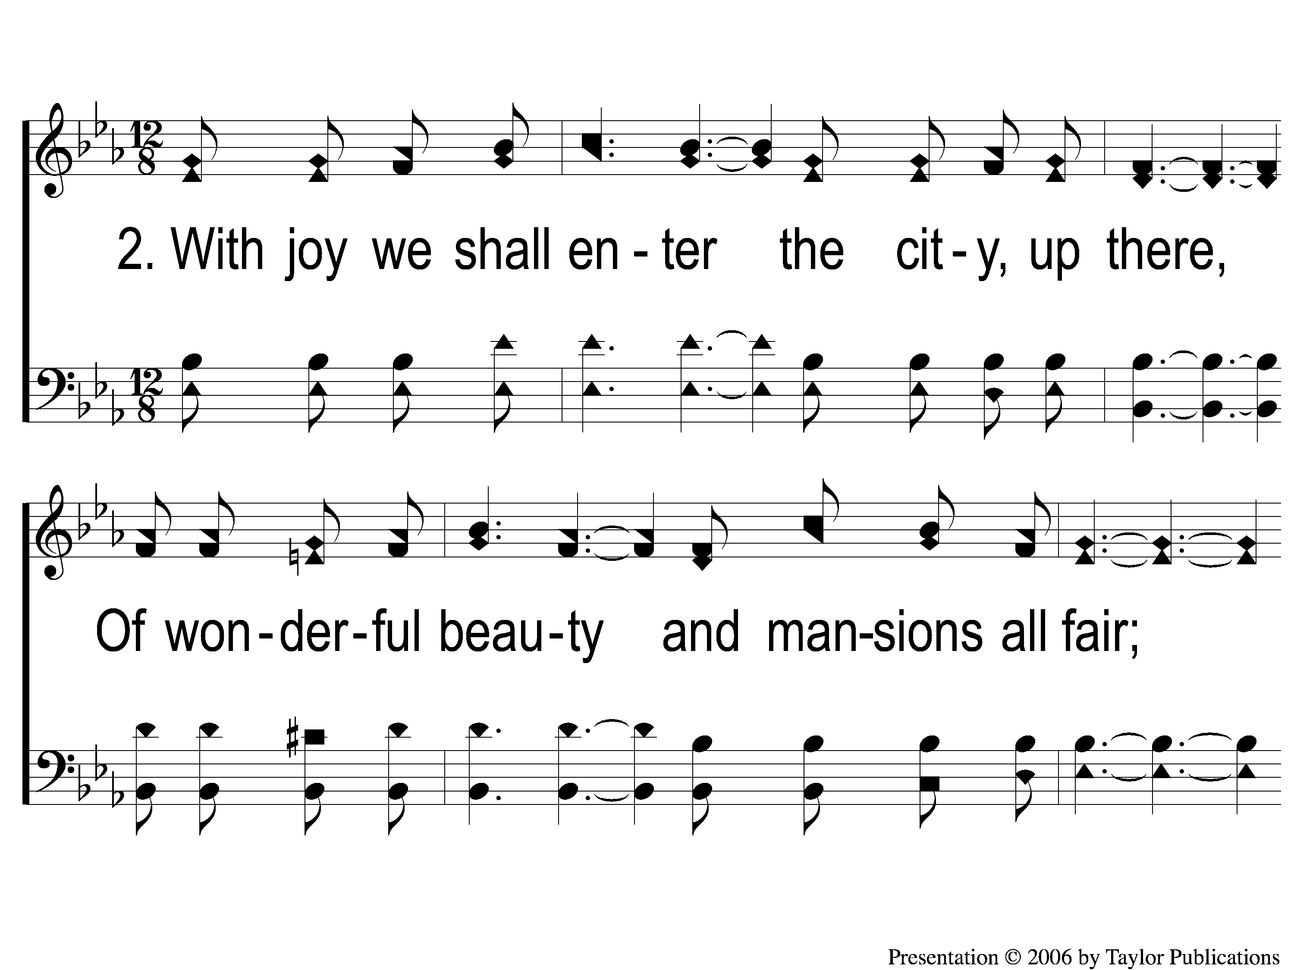
2-1 Each Step of the Way
Each Step of the Way
96

Slide 6
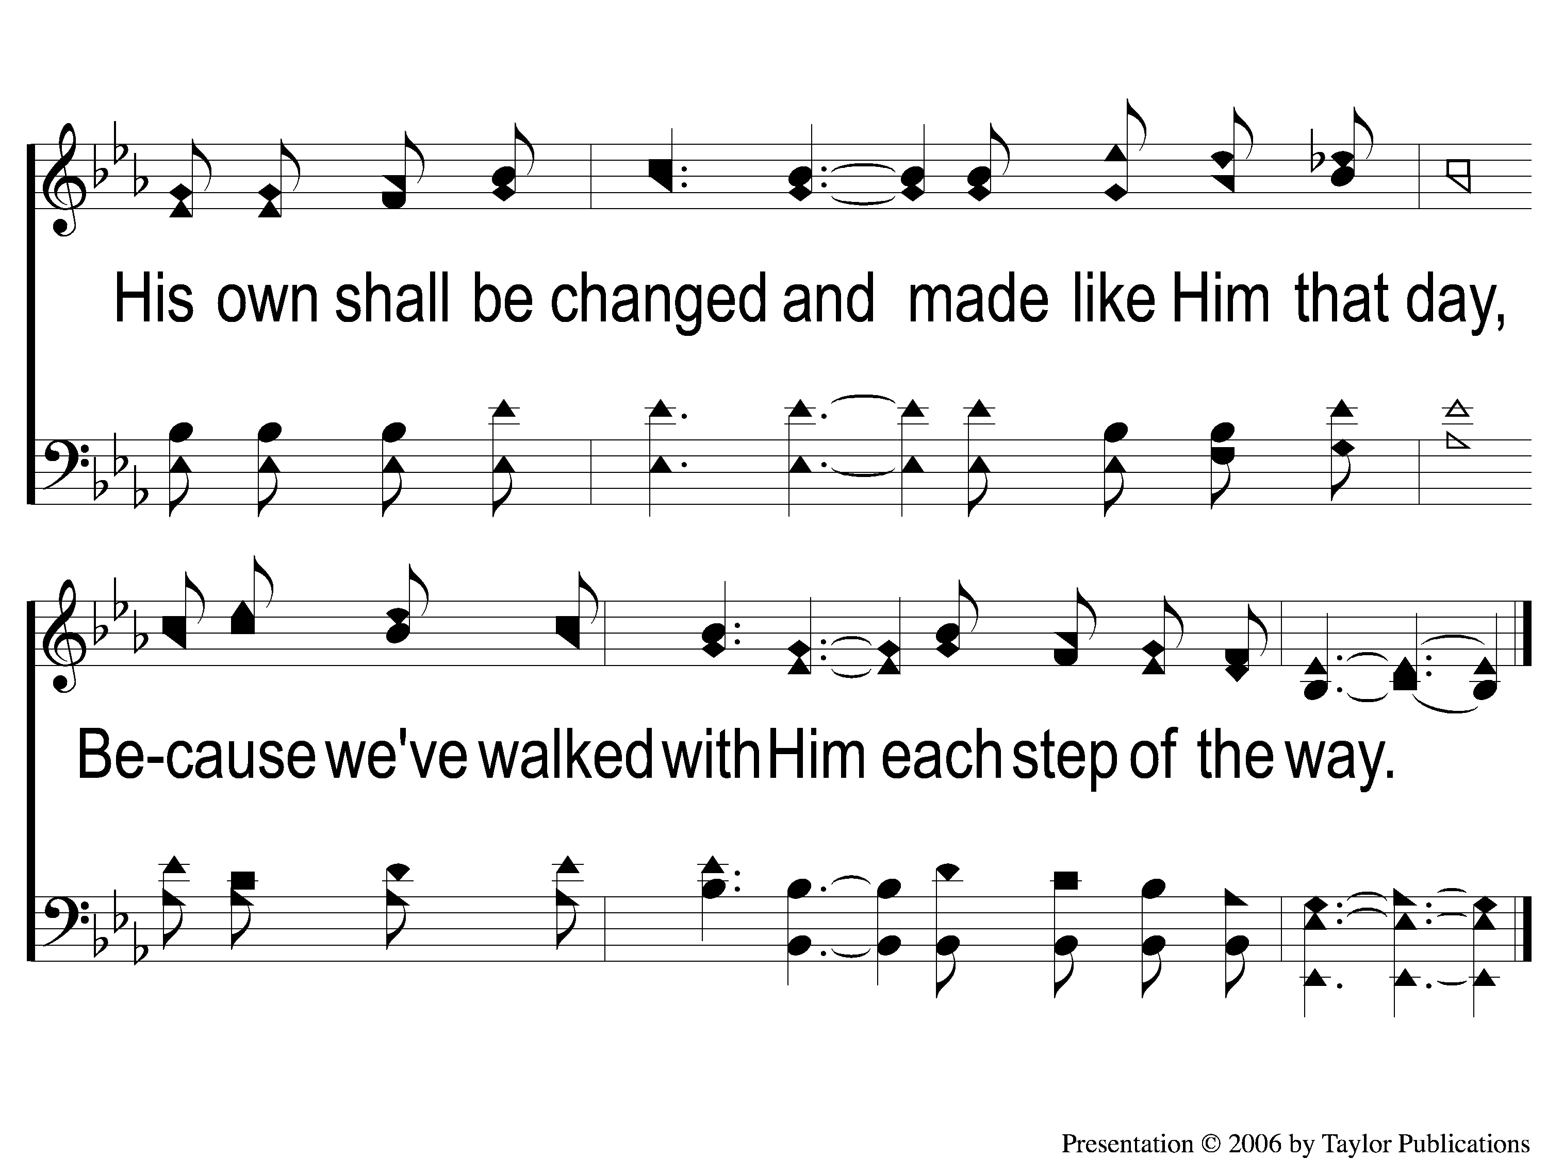
2-2 Each Step of the Way
Each Step of the Way
96

Slide 7
C-1 Each Step of the Way
Each Step of the Way
96

Slide 8
C-2 Each Step of the Way
Each Step of the Way
96

